Slide 1
Organ Transplant Discrimination and People with Intellectual and Developmental Disabilities (I/DD)
Kelly Israel, Policy Analyst, Autistic Self Advocacy Network
Larkin Taylor-Parker, Staff Attorney, Disability Rights North Carolina

Slide 2
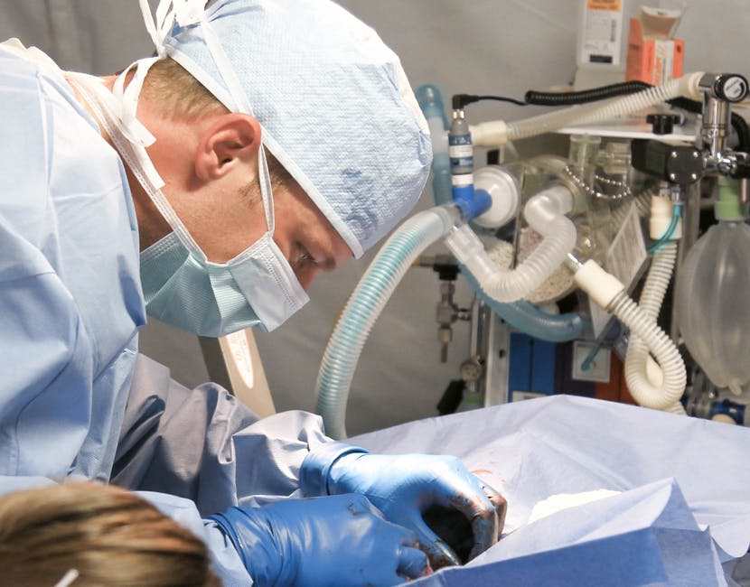
Introduction
People with intellectual and developmental disabilities (I/DD) tend to lack equal access to organ transplantation
Denials of equal access may result from:
Organ transplant center policies that exclude people with I/DD as candidates
Refusals to evaluate a particular candidate’s medical suitability for an organ transplant
The use of psychosocial criteria
Description: Surgeon operating on a patient.

Slide 3
Most Common Reasons for Denial on the Basis of an Intellectual/Developmental Disability
Disability discrimination mainly occurs at the evaluation stage of the organ transplant process
Doctors do not recommend people with I/DD for placement on OPTN’s national waiting list
Reason One: Prejudiced beliefs about the worth of the life of a person with I/DD, given that donor organs are an extremely scarce medical resource
Reason Two: Doctors may believe people with I/DD have worse post-transplant outcomes
Reason Three: Belief that people with I/DD will be unable to comply with the transplant process and complex post-transplant medical regimen
Reason Four: Organ transplant team uses psychosocial criteria, such as history of mental health conditions or a lack of compliance
This tends to screen out candidates with I/DD

Slide 4
Who or What Administers Organ Transplants in the U.S?
Law known as the National Organ Transplant Act of 1984 (NOTA) prohibits anyone from establishing a private market for human organs
Therefore, there must be a publicly-run organ procurement and transplant system in the U.S.
NOTA established Organ Procurement and Transplantation Network (OPTN), which manages procurement, fair distribution, and transplantation of organs
All 253 organ transplant centers are members of OPTN and coordinate with it
United Network for Organ Sharing (UNOS) – sole contractor that manages OPTN, and synonymous with it

Slide 5
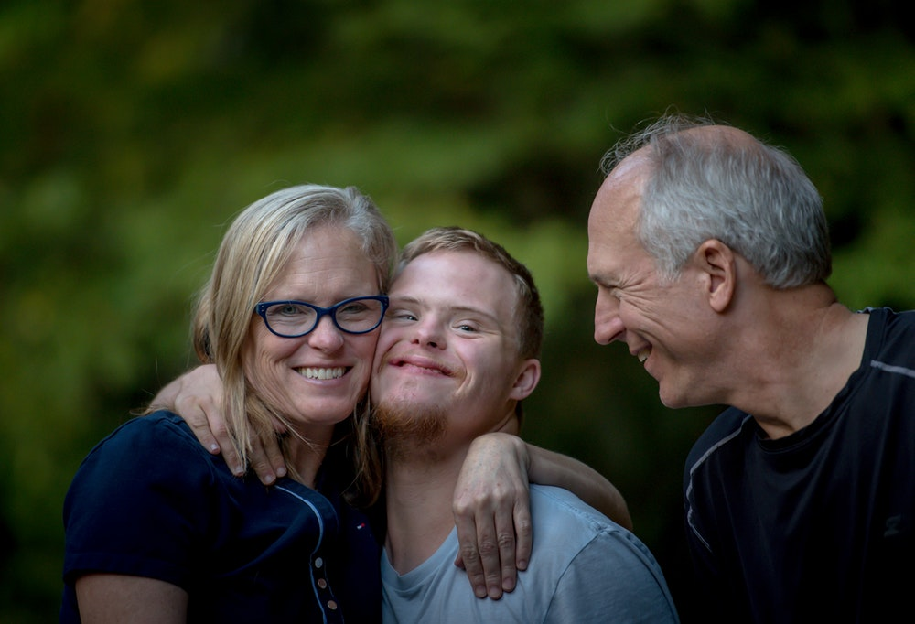
People with I/DD and the Medical Success of Organ Transplants
Description: Two pictures, one on the left and one on the right.
Left Picture: A family hugging each other. There is a man, a woman, and a man who has I/DD that they are hugging.
Right Picture: Young boy in head phones.

Slide 6
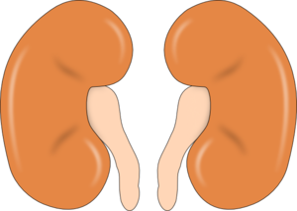
Post Transplant Medical Outcomes for People with I/DD, Pt. 2
Kidney (Renal) Transplants:
A 1998 study ( found that the patient and graft survival rates for eight patients with I/DD 7.5 years were “excellent”
A 2010 study found that patient survival rates after kidney transplants were around 10 percent lower for people with I/DD than controls after five years
However, the same study found that the graft survival rates were identical for people with and without I/DD.
Description: Two cartoon kidneys.

Slide 7
Post-Transplant Medical Outcomes for People with I/DD, Pt. 3
Liver Transplants:
A 2016 study, analyzing data available from UNOS from 2008 through 2013 on children receiving liver transplants for the first time, found that children with intellectual disabilities have comparable short-term graft and patient survival rates to children without intellectual disabilities
They did have more treatment-related hospitalizations than people without disabilities during the first year after transplant
Description: A cartoon lung.

Slide 8
What About Post-Operative Care?
People with I/DD can and do manage complex post-operative care regimens, as long as we have the support that we need
People with I/DD may need a dedicated, consistent circle of support in order to manage post-operative care
People with I/DD may need prompting or reminders in order to for us to take our medications and perform other tasks regularly
None of these support needs mean we should be denied access to organ transplants!
Description: Four people with their hands outstretched and on top of one another in a “coming together” gesture.

Slide 9
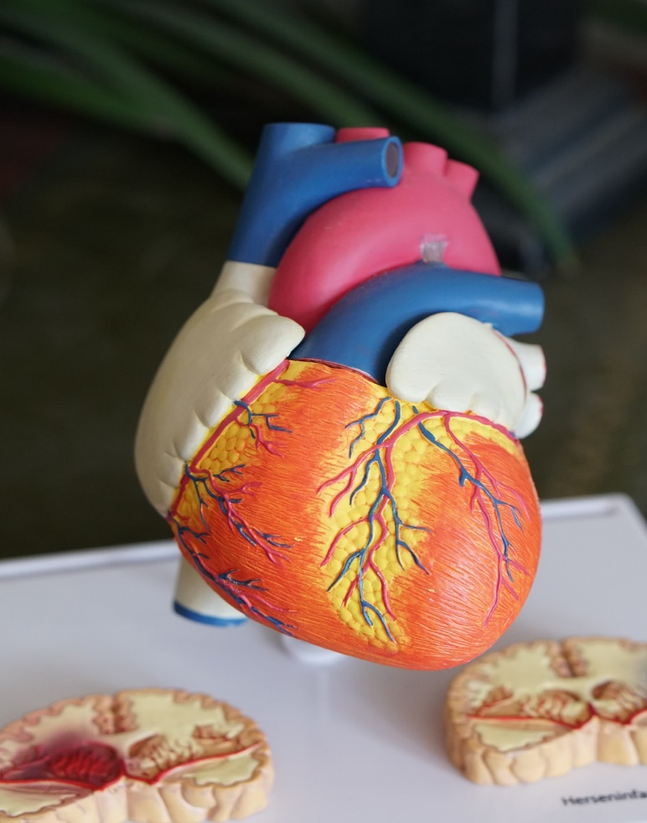
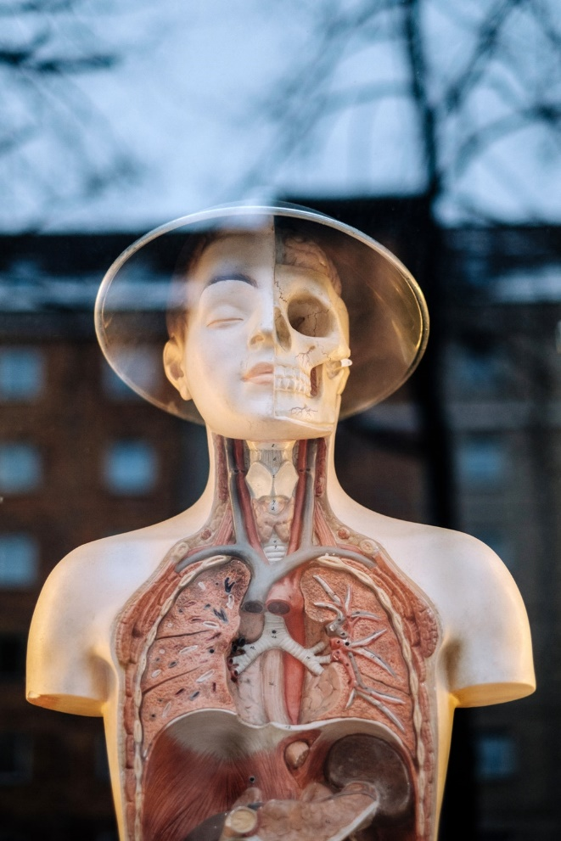
How Organ Transplantation Works
Description: Two pictures, one on the left and one on the right.
Left Picture: An anatomically correct model of a heart.
Right picture: A plastic mannequin with its internal organs visible.

Slide 10
How Organ Transplantation Works, Pt. 1
Step One: A person’s organ begins to fail, and they are evaluated by their physician to determine whether or not an organ transplant is appropriate
Step Two: The doctor decides an organ transplantation is appropriate and provides a referral to one of the nation’s 253 transplant centers
It is possible for disability discrimination to occur at this stage
The doctor could decide not to recommend transplantation or provide a referral on the basis of the patient’s I/DD
Description: A doctor and a patient looking at a computer screen showing health care information.

Slide 11
How Organ Transplantation Works, Pt. 2
Step Three: The person who needs an organ transplant (and their legally authorized decision-makers, if any, such as guardians) calls up one of the 253 organ transplant centers and schedules an evaluation
Doctor usually refers them to a specific center but patient can choose to contact whichever transplant center best meets their needs =
Patient or decision-maker may choose a different organ transplant center than the one their doctor referred them to for any number of reasons, including the center’s location, the amount of time spent on the waitlist, and the affordability of the procedure

Slide 12
How Organ Transplantation Works, Pt. 3
Step Four: The patient meets with the transplant center/hospital’s organ transplant team, and the evaluation takes place
The transplant team asks the patient or their decision-maker questions about their:
Medical history,
Current health,
Social support system
Other aspects of life
Description: A doctor leading a patient by the hand. Image credits: Nicole de Khors, Burst.

Slide 13
How Organ Transplantation Works, Pt. 4
Step Five: The transplant team determines whether they will accept the patient as a candidate for an organ transplant
Organ transplant team’s decisions are typically highly informed by guidelines produced by recognized experts in the field, however…
Organ transplant team typically has a great deal of discretion about which patients to accept
Organ transplant discrimination can enter the process at this stage, as the transplant team could decide a patient with I/DD is not a good candidate based on their I/DD
Step Six: If the transplant team decides to accept the patient as a candidate, they submit the patient to OPTN’s national waiting list for that organ

Slide 14
How Organ Transplantation Works, Pt. 5
OPTN has medical criteria specific to each organ which govern the allocation of donated organs to patients on the waiting list
In general, these criteria focus on four things:
medical compatibility the donor and donee,
how long the patient has been on the waiting list,
the distance between the donated organ or living donor and the recipient
how urgently the transplant is needed.
None of the criteria used by OPTN consider any unrelated disability (such as an intellectual disability) relevant to the allocation decision
Description: A checklist.

Slide 15
How Organ Transplantation Works, Pt. 6
OPTN/UNOS inputs its criteria into a computerized matching system, which generates a list of possible patients who could receive each organ
Step Seven: OPTN/UNOS contacts the transplant team of the highest-ranked patient and offers that patient the organ
Transplant team can refuse or accept, usually for medical reasons
Step Eight: If a transplant team accepts, it will make arrangements with patient and the local Organ Procurement Organization (OPO) to deliver organ

Slide 16
Barriers to Transplant
Would-be organ recipients often have to live where they can reach a hospital at very short notice. After surgery, they must rest and be supported in their daily activities during a long recovery period, maintain access to medical care, including the ability to cover out-of-pocket costs, and keep up with follow-up care to prevent organ rejection.

Slide 17
Organ Allocation is Zero-Sum
Society has been struggling with organ allocation since transplantation became a viable way to extend and improve life. Strategies for allocating scarce medical resources have shifted from concepts like the “God Squad” that governed very early dialysis access toward the pursuit of equitable distribution without determinations of social worth. However, the details of what constitutes fair allocation will remain controversial as long as there is a shortage. Individual and systemic inequality can enter the process at various points and hurt marginalized people’s chances at a transplant.

Slide 18
People with Disabilities and Healthcare
Medicine has a history of failing to effectively serve or actively harming people with disabilities. People with physical disabilities struggle to get basic healthcare because of poor accessibility in medical settings. Behavior changes in people with I/DD or mental health disabilities as a result of discomfort from illness or injury are not always recognized as such.

Slide 19
People with Disabilities and Healthcare
The number of medical practitioners with disabilities, especially doctors, is still fairly low. Medical practitioners are more likely to encounter patients when those patients are suffering than when they are thriving. That, combined with the use of tools that attempt to measure quality of life, can lead to a low evaluation of the value of disabled living.

Slide 20
A Perfect Storm
The zero-sum nature of organ allocation and negative attitudes toward the value of people with disabilities’ lives in medical settings combine to create perfect conditions for discrimination. From talking over options for treating advanced disease with a doctor to getting listed for transplantation, there are many opportunities for a person with a disability’s candidacy for organ transplant to derail.

Slide 21
Organ Transplant Discrimination Against People With I/DD and The Law
Description: Two pictures, one on the left and one on the right.
Left Picture: A photo of a gavel.
Right Picture: The Supreme Court.

Slide 22
Rarely-Litigated Issue
Individual organ allocation and transplant listing are rarely litigated because people who need organs need them urgently, and litigation takes time. Courts are also reluctant to interfere with doctors’ decisions about who is a medically appropriate transplant recipient.
Description: sand falls through an hourglass surrounded by clocks.

Slide 23
Litigation
Litigation regarding limits on Medicaid or private insurance coverage for transplantation and associated care has been more common. However, a family's challenge to an OPTN rule limiting children under 12's access to lungs from older donors did result in a TRO and several children being listed as if they were 12 or older while the case progressed. See Murnaghan v. United States Department of Health and Human Services, No. 13-3083 (E.D. Pa. June 5, 2013). OPTN ultimately changed the rule. A challenge to geography playing a significant role in the distribution of lungs was successful in 2017. See Holman v. United States Department of Health and Human Services, No. 17-09041 (S.D.N.Y. 2017 Nov. 11, 2017).

Slide 24
Federal Statutes
Titles II and III of the ADA, the Rehabilitation Act, and the ACA may apply to a given medical setting.
Description: two shelves of books.

Slide 25
ADA and §504
Enforced by HHS OCR
Guarantee access for qualified persons with disabilities
Guarantee of reasonable accommodations if needed to allow qualified persons with disabilities to use the program or service
Rehabilitation Act applies to religious hospitals receiving federal funding

Slide 26
ACA §1557
Enforced by HHS OCR
Covers health programs or activities receiving federal funding, including insurance marketplaces
Covers programs and activities administered by Executive agencies
Covers programs and activities established under Title I of the ACA or its amendments
Prohibits discrimination as defined in Section 504 of the Rehabilitation Act

Slide 27
Federal Law Protects:
Good transplant candidates with disabilities from being declined listing merely because a doctor or hospital believes saving a nondisabled life is a better use of scarce organs
People with disabilities’ right to reasonable accommodations in the transplant process

Slide 28
States with additional protections:
California
Kansas
Maryland
Massachusetts
New Jersey
Oregon
Pennsylvania
Description: an old, decorative map of the United States.

Slide 29
In Closing
Legal advocacy for people with disabilities who have been denied transplant listing on a discriminatory basis is an opportunity to save lives, draw our disability rights statutes out to their logical conclusion of full equality under law even in the most extreme circumstances, assert the full value of disabled life, and protect the transplant system, itself.

Slide 30
Questions? Comments?

